Slide 1
HOTDOG.py:
Two Hotdogs’ Journey to a Backyard BBQ
(aka some fun with python)
Playfully created by Vallie E Tracy

Slide 2
MY BACKGROUND
Changing careers
real estate
math
data analysis
Python
bootcamp thru the U
5-week course early winter
Looking for work
swiping right

Slide 3
OBJECTIVES
Practice
functions
variety of python capabilities
loops (for & while)
exception handling
data types
.capwords(), .replace(), etc
very open-ended!!
Be creative
have fun

Slide 4
PROCESS Coming up with an idea
Immediately dove in
== no pseudocode
Positives:
started to see some things I wanted to focus on
got creative juices flowing
Dialed it back
wrote pseudocode

Slide 5
Minimum Viable Product:
3 MAIN SECTIONS
1.) Introductory conversation function
-focused on strings
2.) Driving Directions function
-integers, appending list
-calling another function that focused on equations
3.) Ending grocery shopping function
-build a dictionary of key:value pairs made of strings and floats

Slide 6
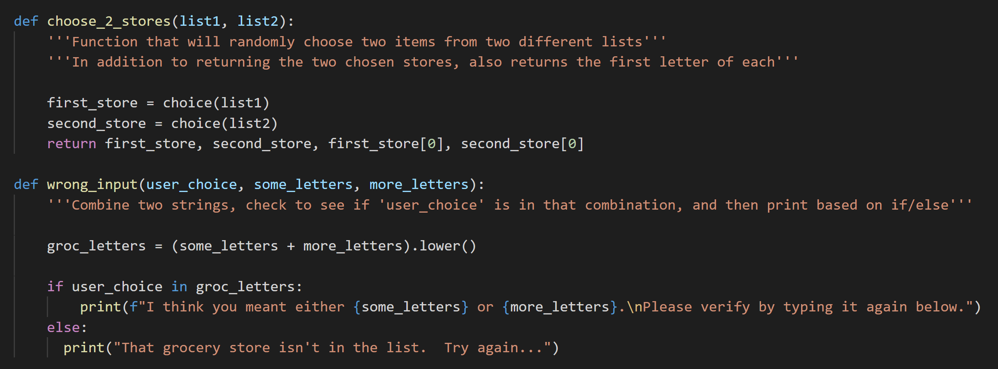
What it made me think about

Slide 7
Challenges
Refactoring code as the code got longer and more complex
Pseudocode is helpful!
Storing function output to call elsewhere

Slide 8
DEMO TIME!

